Slide 1
L. 14. Molecular Markers
Classification of Markers.
Morphological Markers
Biochemical Markers.
Molecular Markers

Slide 2
Classification Of Markers
Marker is generally defined as an object used to indicate a position, place, or route.
Morphological Markers
Molecular Markers
Biochemical
Markers
DNA Based
Markers

Slide 3





DNA Based
Markers
Anonymous
Markers
PCR Based Markers
Defined or polymorphic Markers
Hybridization Based Markers
)

Slide 4
Morphological markers
These markers are often detectable by eye, by simple visual inspection .These are Classical markers which are also known as “naked eye polymorphism”.
Selected based on the experience of the breeder to correlate a phenotypic trait with a trait of interest.
Examples of this type of marker include the presence or absence of an awn, leaf sheath coloration, height, grain color, aroma of rice etc.
In well characterized crops like maize, tomato, pea, barley & wheat tens or hundreds of genes that determine morphological traits have been mapped to specific chromosome locations.
A best example is to use leaf tip necrosis(LTN) as a phenotypic marker to predict the presence of durable rust resistance gene pair Lr34/Yr18 in wheat.
Another example is to use pseudo black chaff seen on glumes & below the nodes color as a morphological marker to predict the presence of stem rust resistance gene Sr2 in wheat.

Slide 5
Molecular markers
A sequence of DNA or protein that can be screened to reveal key or composition and thus used to reveal genetic variation
Also known as “Genetic Marker”.
Genetic markers are the sequences of DNA which have been traced to specific location on the chromosomes and associated with particular traits.
Molecular Markers are classified as:
Protein Based Markers/ Biochemical Markers
DNA Based Markers

Slide 6




Comparison of molecular & morphological markers
Represent the actual polymorphism of the phenotype important for the breeder.
Represent naturally occurring polymorphism in DNA sequence (i.e. base pair deletion, substitution, addition or patterns)
Generally scored in laboratory.
Comparatively less time consuming and do not require large population.
Generally scored quickly, simply and without laboratory equipments.
Influenced by environment, Time consuming, require large population.

Slide 7
Protein based or Biochemical markers
Isozymes analysis has been used for over 60 years for various research purposes in biology, viz. to delineate phylogenetic relationships, to estimate genetic variability and taxonomy, to study population genetics and developmental biology, to characterization in plant genetic resources management and plant breeding.
Isozymes were defined as structurally different molecular forms of an enzyme with, qualitatively, the same catalytic function. Isozymes originate through amino acid alterations, which cause changes in net charge, or the spatial structure (conformation) of the enzyme molecules and also, therefore, their electrophoretic mobility. After specific staining the isozyme profile of individual samples can be observed.
Allozymes are allelic variants of enzymes encoded by structural genes. Allelic variation can be detected by gel electrophoresis and subsequent enzyme-specific stains that contain substrate for the enzyme.

Slide 8
Advantages:
Allozyme analysis does not require DNA extraction or the availability of sequence information, primers or probes, they are quick and easy to use.
Simple analytical procedures, allow some allozymes to be applied at relatively low costs, depending on the enzyme staining reagents used.
Allozymes are
reproducibility.
codominant markers that have high
Zymograms (the banding pattern of
isozymes) can be readily interpreted in terms of loci and alleles.

Slide 9
DNA Based Markers
DNA marker = direct reflection of genotype.
“Any unique DNA sequence which can be used in DNA hybridization, PCR or restriction mapping experiments to identify target sequence.”
In 1980, variations in the pattern of DNA fragments were observed , generated by restriction enzyme digestion of genomic DNA , could be used as genetic marker.
DNA-markers allow the breeder to introduce into their cultivated plant only the gene(s) of interest from a related species as compare to conventional breeding.

Slide 10









CONVENTIONAL BACKCROSSING
MARKER-ASSISTED BACKCROSSING
P₁ x P₂
P₁ x P₂
P₁ x F₁
P₁ x F₁
BC1
BC1
VISUAL SELECTION OF BC1 PLANTS THAT MOST CLOSELY RESEMBLE RECURRENT PARENT
USE ‘BACKGROUND’ MARKERS TO SELECT PLANTS THAT HAVE MOST RP MARKERS AND SMALLEST % OF DONOR GENOME
BC2
BC2

Slide 11
Allow eliminating the undesired genomic regions in a few generations .
Segregate as single genes.
Not affected by the environment.
DNA based markers are classified as:
Anonymous Markers
Defined Markers
Anonymous Markers:
“A cloned random DNA fragment whose function or specific features are not known e.g. Microsatellites and AFLP. These marker type generally measure apparently neutral DNA variations.

Slide 12
Defined Marker OR Polymorphic marker:
“A defined marker may contain a gene or some other specific features, e.g. restriction sites for cutting by the restriction enzymes, etc.”
Polymorphism of DNA Marker:
“DNA markers representing polymorphism in the actual base sequence of DNA.”
This can be represented by:
Mutation at restriction site.
Insertion or deletion between restriction sites.
Mutations at single nucleotide.
Changes in number of repeat unit between restriction site or PCR primer sites.

Slide 13
Cl
assification of Marke
rs
Name of the technique |  | Discoverer
A. Biochemical Markers | Allozymes | Tanksley and Orton 1983;Kephart1990; May 1992
B. Molecular Markers i) Non-PCR based techniques | Restriction Fragment Length Polymorphisms (RFLP) | Botstein et al. 1980; Neale and Williams 1991
 | Minisatellites or Variable Number of Tandem Repeats (VNTR) | Jeffreys et al.. 1985
ii) PCR-based techniques DNA sequencing | Multi-copy DNA, Internal Transcribed Spacer regions of nuclear ribosomal genes (ITS) | Takaiwa et al. 1985; Dillon et al. 2001
 | Single-copy DNA, including both introns and exons | Sanger et al. 1977; Clegg 1993a

Slide 14
 | Sequence Tagged Sites(STS) | Microsatellites, Simple Sequence Repeat (SSR), Short Tandem Repeat (STR), Sequence Tagged Microsatellite (STMS) or Simple Sequence Length Polymorphism (SSLP) | Litt and Lutty (1989),Hearne et al. 1992; Morgante and Olivieri 1993; Jarne and Lagoda 1996
 | Sequence Characterized Amplified Region (SCAR) |  | Michelmore et al. (1991); Martin et al. (1991); Paran and Michelmore 1993
 | Cleaved Amplified Polymorphic Sequence (CAPS) |  | Akopyanz et al. 1992; Konieczny and Ausubel 1993
 | Single-Strand Conformation Polymorphism (SSCP) |  | Hayashi 1992

Slide 15
 | Denaturing Gradient Gel Electrophoresis (DGGE) |  | Riedel et al. 1990
 | Thermal Gradient Gel Electrophoresis (TGGE) |  | Riesner et al. 1989
 | Heteroduplex Analysis (HDA) |  | Perez et al. 1999; Schneider et al. 1999
 | Denaturing High Performance Liquid Chromatography (DHPLC) |  | Hauser et al. 1998; Steinmetz et al. 2000; Kota et al. 2001
 | Multiple Arbitrary Amplicon Profiling (MAAP) |  | Caetano-Anolles 1996; Caetano- Anolles et al. 1992
 | Random Amplified Polymorphic DNA (RAPD) |  | Williams et al. 1990; Hadrys et al. 1992

Slide 16
 | DNA Amplification Fingerprinting (DAF) | Caetano-Anolles et al. 1991
 | Arbitrarily Primed Polymerase Chain Reaction (AP-PCR) | Welsh and McClelland 1990; Williams et al. 1990
 | Inter-Simple Sequence Repeat (ISSR) | Zietkiewicz et al. 1994; Godwin et al. 1997
 | Single Primer Amplification Reaction (SPAR) | Staub et al. 1996
 | Directed Amplification of Minisatellites DNA (DAMD) | Heath et al. 1993; Somers and Demmon 2002
 | Amplified Fragment Length Polymorphism (AFLP) | Vos et al. 1995
 | Selectively Amplified Microsatellite Polymorphic Loci (SAMPL) | Witsenboer et al. 1997

Slide 17








Non- PCR or Hybridization Based Markers
“The variation in the length of DNA fragments produced by specific Restriction Endonucleases from genomic DNA s of two or more individuals of a species is called hybridization and markers produced by this technique are called
hybridization based molecular markers.”
This type of hybridization marker includes-
RFLP

Slide 18





RFLP
“RFLP is restriction fragment length polymorphism, which are variations in the DNA sequence of an individual which may be detected by Restriction Endonucleases, which cut the double stranded DNA whenever they recognize a highly specific oligonucleotide sequence or a
restriction site.”
RFLP Analysis
“ A molecular method of genetic analysis that allows individuals to be identified on the basis of unique patterns of restriction enzymes cutting in specific regions of DNA. It is an application of Southern Hybridization Procedure. ”

Slide 19
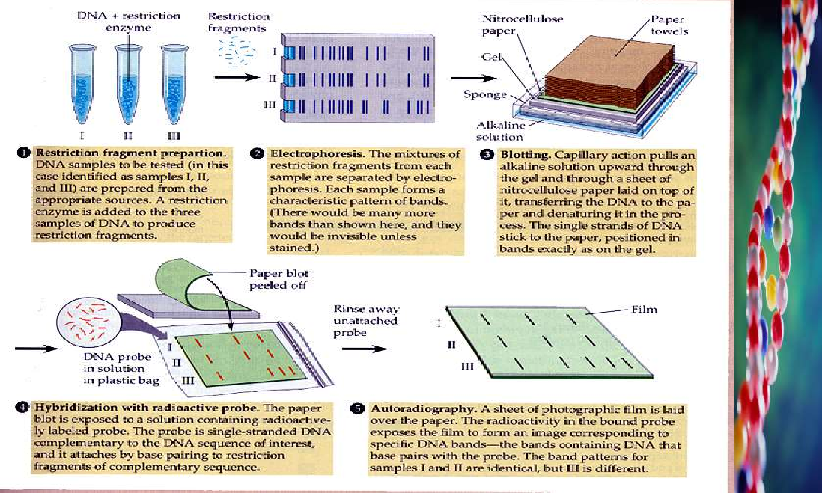

Slide 20
Advantages of RFLP-
They are co-dominant.
Measure variation at the level of DNA sequence, not protein sequence.
RFLP loci are very large so even very small segments of chromosomes can be mapped and also study phylogenetic relationship.
Very reliable for linkage analysis and for detecting coupling phase of DNA molecules.

Slide 21
Disadvantages:
The development of SSRs is labor intensive
SSR marker development costs are very high
Start-up costs are high for automated SSR assay methods.
Developing PCR multiplexes is difficult and expensive.
Some markers may not multiplex.

